Slide 1
Layout Widgets in Flutter
Widgets are classes used to build UIs.
Widgets are used for both layout and UI elements.
Compose simple widgets to build complex widgets.

Slide 2


Everything is widget
The core of Flutter’s layout mechanism is widgets. In Flutter, almost everything is a widget—even layout models are widgets. The images, icons, and text that you see in a Flutter app are all widgets. But things you don’t see are also widgets, such as the rows, columns, and grids that arrange, constrain, and align the visible widgets.
You create a layout by composing widgets to build more complex widgets. For example, the first screenshot below shows 3 icons with a label under each one:

Slide 3
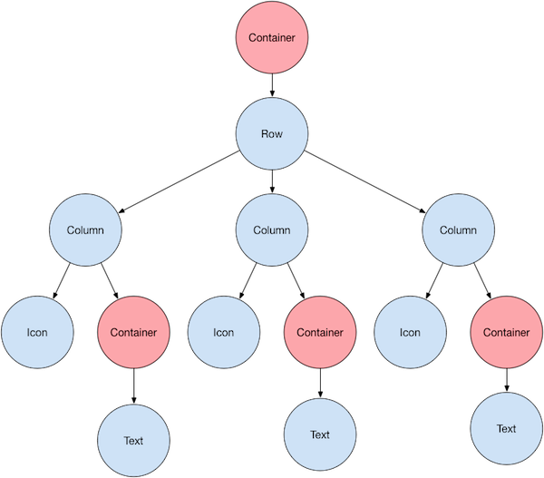
Here’s a diagram of the widget tree for this UI:

Slide 4
Lay out a widget
Select a layout widget: Choose from a variety of layout widgets based on how you want to align or constrain the visible widget, as these characteristics are typically passed on to the contained widget. This example uses Center which centers its content horizontally and vertically.
Create a visible widget:
Text (‘Hello World’),
Image.asset(
'images/lake.jpg',
fit: BoxFit.cover,
),
Icon(
Icons.star,
color: Colors.red[500],
),
Add the layout widget to the page
Center(
child: Text('Hello World'),
),
Add the layout widget to the page
A Flutter app is itself a widget, and most widgets have a build() method. Instantiating and returning a widget in the app’s build() method displays the widget.

Slide 5
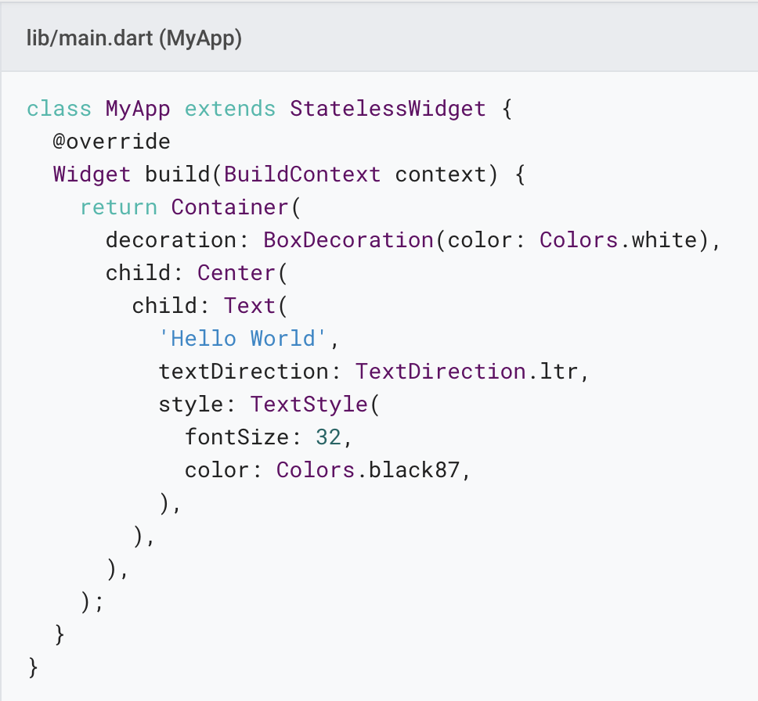
Non-Material apps
For a non-Material app, you can add the Center widget to the app’s build() method:

Slide 6
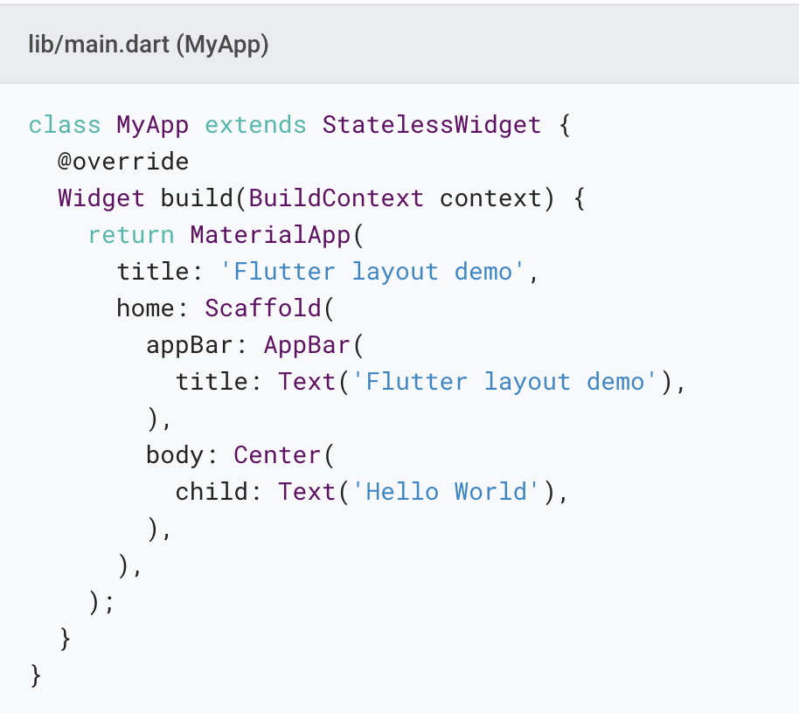
Material apps
For a Material app, you can use a Scaffold widget; it provides a default banner, background color, and has API for adding drawers, snack bars, and bottom sheets. Then you can add the Center widget directly to the body property for the home page.

Slide 7
Layout multiple widgets vertically and horizontally
Row and Column are two of the most commonly used layout patterns.
Row and Column each take a list of child widgets.
A child widget can itself be a Row, Column, or other complex widget.
You can specify how a Row or Column aligns its children, both vertically and horizontally.
You can stretch or constrain specific child widgets.
You can specify how child widgets use the Row’s or Column’s available space.

Slide 8
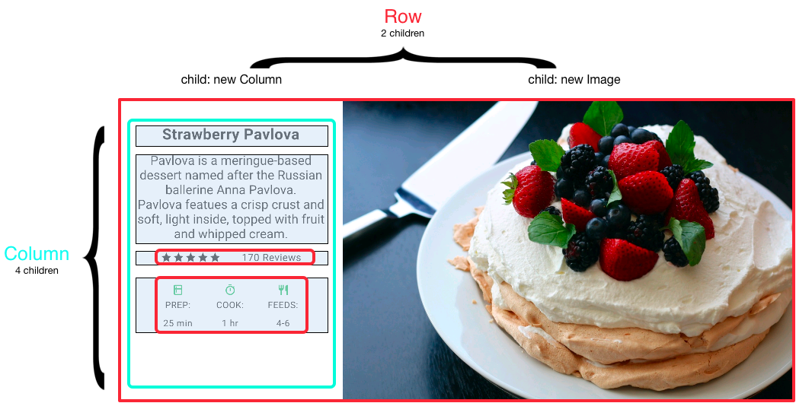
Layout multiple widgets with row and column
To create a row or column in Flutter, you add a list of children widgets to a Row or Column widget. In turn, each child can itself be a row or column, and so on. The following example shows how it is possible to nest rows or columns inside of rows or columns.
This layout is organized as a Row. The row contains two children: a column on the left, and an image on the right:

Slide 9
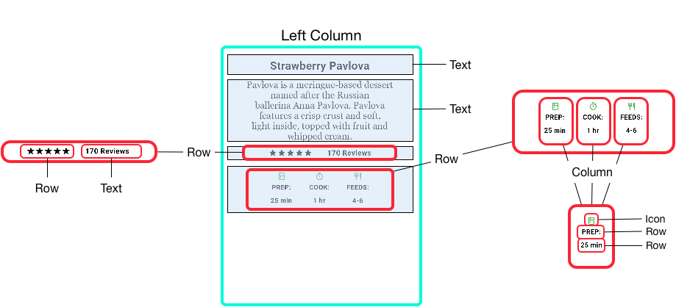

Slide 10
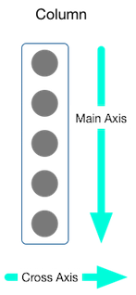
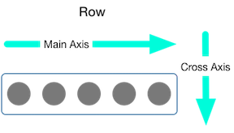
Aligning widgets
You control how a row or column aligns its children using the mainAxisAlignment and crossAxisAlignment properties. For a row, the main axis runs horizontally and the cross axis runs vertically. For a column, the main axis runs vertically and the cross axis runs horizontally.
The MainAxisAlignment and CrossAxisAlignment classes offer a variety of constants for controlling alignment.

Slide 11

ROW
In the following example, each of the 3 images is 100 pixels wide. The render box (in this case, the entire screen) is more than 300 pixels wide, so setting the main axis alignment to spaceEvenly divides the free horizontal space evenly between, before, and after each image.
Row(
mainAxisAlignment: MainAxisAlignment.spaceEvenly,
children: [
Image.asset('images/pic1.jpg'),
Image.asset('images/pic2.jpg'),
Image.asset('images/pic3.jpg'),
],
);

Slide 12
Column
Columns work the same way as rows. The following example shows a column of 3 images, each is 100 pixels high. The height of the render box (in this case, the entire screen) is more than 300 pixels, so setting the main axis alignment to spaceEvenly divides the free vertical space evenly between, above, and below each image.
Column(
mainAxisAlignment: MainAxisAlignment.spaceEvenly,
children: [
Image.asset('images/pic1.jpg'),
Image.asset('images/pic2.jpg'),
Image.asset('images/pic3.jpg'),
],
);

Slide 13
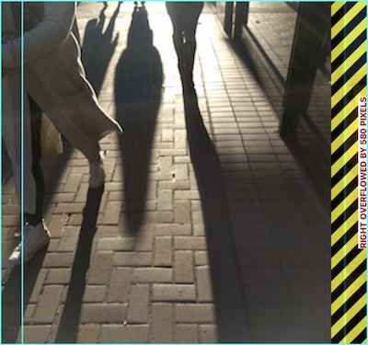
Sizing widgets
When a layout is too large to fit a device, a yellow and black striped pattern appears along the affected edge. Here is an example of a row that is too wide:

Slide 14
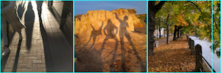
Widgets can be sized to fit within a row or column by using the Expanded widget. To fix the previous example where the row of images is too wide for its render box, wrap each image with an Expanded widget.
Row(
crossAxisAlignment: CrossAxisAlignment.center,
children: [
Expanded(
child: Image.asset('images/pic1.jpg'),
),
Expanded(
child: Image.asset('images/pic2.jpg'),
),
Expanded(
child: Image.asset('images/pic3.jpg'),
),
],
);

Slide 15
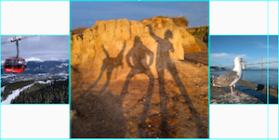
Perhaps you want a widget to occupy twice as much space as its siblings. For this, use the Expanded widget flex property, an integer that determines the flex factor for a widget. The default flex factor is 1. The following code sets the flex factor of the middle image to 2:
Row(
crossAxisAlignment: CrossAxisAlignment.center,
children: [
Expanded(
child: Image.asset('images/pic1.jpg'),
),
Expanded(
flex: 2,
child: Image.asset('images/pic2.jpg'),
),
Expanded(
child: Image.asset('images/pic3.jpg'),
),
],
);

Slide 16

Packing widgets
By default, a row or column occupies as much space along its main axis as possible, but if you want to pack the children closely together, set its mainAxisSize to MainAxisSize.min. The following example uses this property to pack the star icons together.
Row(
mainAxisSize: MainAxisSize.min,
children: [
Icon(Icons.star, color: Colors.green[500]),
Icon(Icons.star, color: Colors.green[500]),
Icon(Icons.star, color: Colors.green[500]),
Icon(Icons.star, color: Colors.black),
Icon(Icons.star, color: Colors.black),
],
)

Slide 17
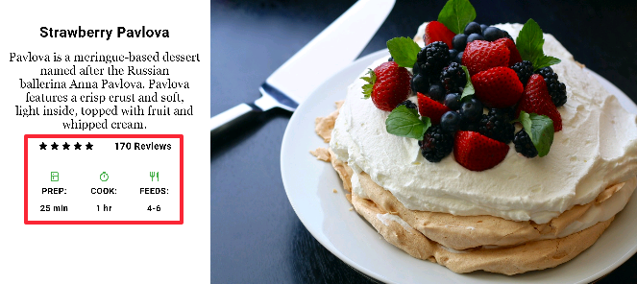
Nesting rows and columns
The outlined section is implemented as two rows. The ratings row contains five stars and the number of reviews. The icons row contains three columns of icons and text.
The layout framework allows you to nest rows and columns inside of rows and columns as deeply as you need. Let’s look at the code for the outlined section of the following layout:

Slide 18
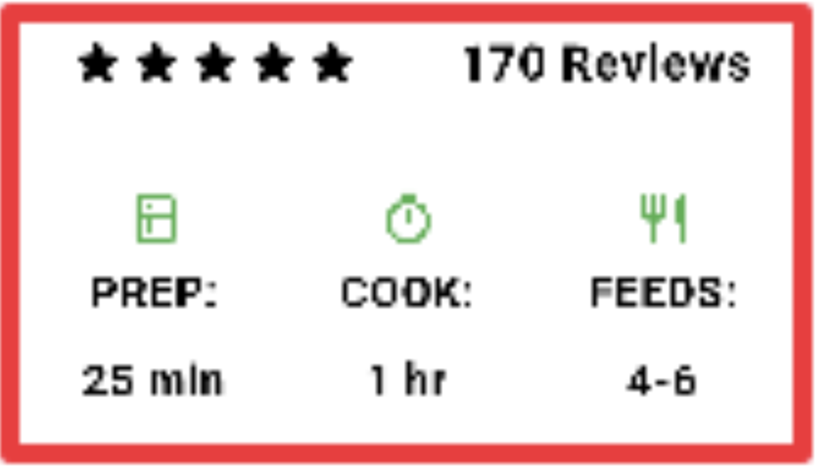
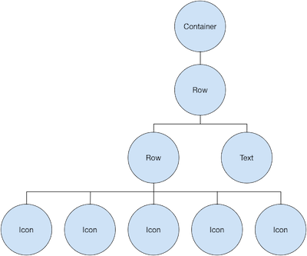
The widget tree for the ratings row:
var stars = Row(
mainAxisSize: MainAxisSize.min,
children: [
Icon(Icons.star, color: Colors.green[500]),
Icon(Icons.star, color: Colors.green[500]),
Icon(Icons.star, color: Colors.green[500]),
Icon(Icons.star, color: Colors.black),
Icon(Icons.star, color: Colors.black),
],
);
final ratings = Container(
padding: EdgeInsets.all(20),
child: Row(
mainAxisAlignment: MainAxisAlignment.spaceEvenly,
children: [
stars,
Text(
'170 Reviews',
style: TextStyle(
color: Colors.black,
fontWeight: FontWeight.w800,
fontFamily: 'Roboto',
letterSpacing: 0.5,
fontSize: 20,
),
),
],
),
);

Slide 19
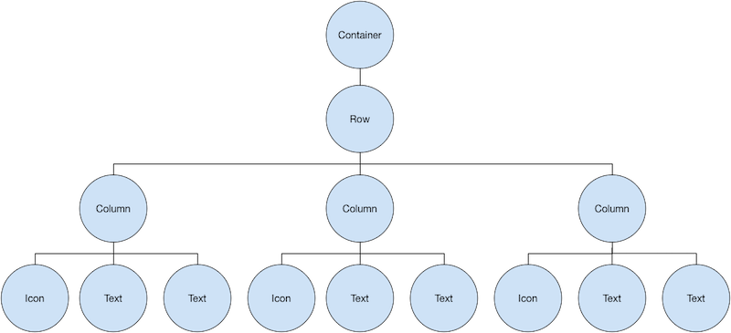
The icons row, below the ratings row, contains 3 columns; each column contains an icon and two lines of text, as you can see in its widget tree:
final descTextStyle = TextStyle(
color: Colors.black,
fontWeight: FontWeight.w800,
fontFamily: 'Roboto',
letterSpacing: 0.5,
fontSize: 18,
height: 2,
);
// DefaultTextStyle.merge() allows you to create a default text
// style that is inherited by its child and all subsequent children.
final iconList = DefaultTextStyle.merge(
style: descTextStyle,
child: Container(
padding: EdgeInsets.all(20),
child: Row(
mainAxisAlignment: MainAxisAlignment.spaceEvenly,
children: [
Column(
children: [
Icon(Icons.kitchen, color: Colors.green[500]),
Text('PREP:'),
Text('25 min'),
],
),
Column(
children: [
Icon(Icons.timer, color: Colors.green[500]),
Text('COOK:'),
Text('1 hr'),
],
),
Column(
children: [
Icon(Icons.restaurant, color: Colors.green[500]),
Text('FEEDS:'),
Text('4-6'),
],
),
],
),
),
);

Slide 20
final leftColumn = Container(
padding: EdgeInsets.fromLTRB(20, 30, 20, 20),
child: Column(
children: [
titleText,
subTitle,
ratings,
iconList,
],
),
);

Slide 21
body: Center(
child: Container(
margin: EdgeInsets.fromLTRB(0, 40, 0, 30),
height: 600,
child: Card(
child: Row(
crossAxisAlignment: CrossAxisAlignment.start,
children: [
Container(
width: 440,
child: leftColumn,
),
mainImage,
],
),
),
),
),

Slide 22
Common layout widget
https://flutter.dev/docs/development/ui/widgets/layout
https://flutter.dev/docs/development/ui/widgets/basics
https://flutter.dev/docs/development/ui/widgets

Slide 23
Standard widgets
Container: Adds padding, margins, borders, background color, or other decorations to a widget.
GridView: Lays widgets out as a scrollable grid.
ListView: Lays widgets out as a scrollable list.
Stack: Overlaps a widget on top of another.

Slide 24
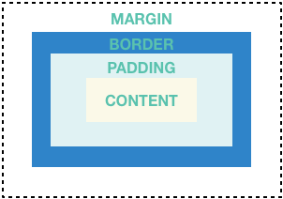
Container
Many layouts make liberal use of Containers to separate widgets using padding, or to add borders or margins. You can change the device’s background by placing the entire layout into a Container and changing its background color or image.
Summary (Container)
Add padding, margins, borders
Change background color or image
Contains a single child widget, but that child can be a Row, Column, or even the root of a widget tree

Slide 25
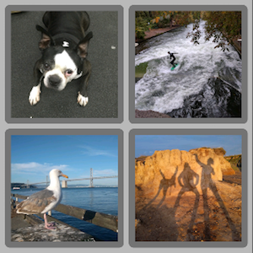
This layout consists of a column with two rows, each containing 2 images. A Container is used to change the background color of the column to a lighter grey.
Widget _buildImageColumn() => Container(
decoration: BoxDecoration(
color: Colors.black26,
),
child: Column(
children: [
_buildImageRow(1),
_buildImageRow(3),
],
),
);

Slide 26
A Container is also used to add a rounded border and margins to each image:
Widget _buildDecoratedImage(int imageIndex) => Expanded(
child: Container(
decoration: BoxDecoration(
border: Border.all(width: 10, color: Colors.black38),
borderRadius: const BorderRadius.all(const Radius.circular(8)),
),
margin: const EdgeInsets.all(4),
child: Image.asset('images/pic$imageIndex.jpg'),
),
);
Widget _buildImageRow(int imageIndex) => Row(
children: [
_buildDecoratedImage(imageIndex),
_buildDecoratedImage(imageIndex + 1),
],
);
https://github.com/flutter/website/tree/master/examples/layout/container

Slide 27
GridView
Use GridView to lay widgets out as a two-dimensional list. GridView provides two pre-fabricated lists, or you can build your own custom grid. When a GridView detects that its contents are too long to fit the render box, it automatically scrolls.
Summary (GridView)
Lays widgets out in a grid
Detects when the column content exceeds the render box and automatically provides scrolling
Build your own custom grid, or use one of the provided grids:
GridView.count allows you to specify the number of columns
GridView.extent allows you to specify the maximum pixel width of a tile

Slide 28
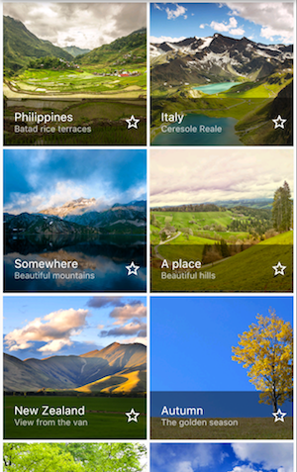
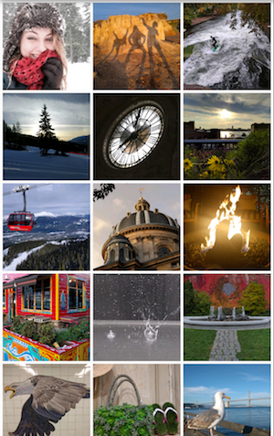
GridView
Widget _buildGrid() => GridView.extent(
maxCrossAxisExtent: 150,
padding: const EdgeInsets.all(4),
mainAxisSpacing: 4,
crossAxisSpacing: 4,
children: _buildGridTileList(30));
List<Container> _buildGridTileList(int count) => List.generate(
count, (i) => Container(child: Image.asset('images/pic$i.jpg')));
https://github.com/flutter/website/tree/master/examples/layout/grid_and_list
Uses GridView.count to create a grid that’s 2 tiles wide in portrait mode, and 3 tiles wide in landscape mode. The titles are created by setting the footer property for each GridTile.
Uses GridView.extent to create a grid with tiles a maximum 150 pixels wide.

Slide 29
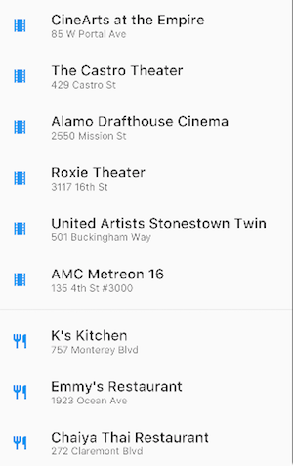
ListView
ListView, a column-like widget, automatically provides scrolling when its content is too long for its render box.
Summary (ListView)
A specialized Column for organizing a list of boxes
Can be laid out horizontally or vertically
Detects when its content won’t fit and provides scrolling
Less configurable than Column, but easier to use and supports scrolling
https://github.com/flutter/website/tree/master/examples/layout/grid_and_list

Slide 30
Widget _buildList() => ListView(
children: [
_tile('CineArts at the Empire', '85 W Portal Ave', Icons.theaters),
_tile('The Castro Theater', '429 Castro St', Icons.theaters),
_tile('Alamo Drafthouse Cinema', '2550 Mission St', Icons.theaters),
_tile('Roxie Theater', '3117 16th St', Icons.theaters),
_tile('United Artists Stonestown Twin', '501 Buckingham Way',
Icons.theaters),
_tile('AMC Metreon 16', '135 4th St #3000', Icons.theaters),
Divider(),
_tile('K\'s Kitchen', '757 Monterey Blvd', Icons.restaurant),
_tile('Emmy\'s Restaurant', '1923 Ocean Ave', Icons.restaurant),
_tile(
'Chaiya Thai Restaurant', '272 Claremont Blvd', Icons.restaurant),
_tile('La Ciccia', '291 30th St', Icons.restaurant),
],
);
ListTile _tile(String title, String subtitle, IconData icon) => ListTile(
title: Text(title,
style: TextStyle(
fontWeight: FontWeight.w500,
fontSize: 20,
)),
subtitle: Text(subtitle),
leading: Icon(
icon,
color: Colors.blue[500],
),
);

Slide 31
Stack
Use Stack to arrange widgets on top of a base widget—often an image. The widgets can completely or partially overlap the base widget
Summary (Stack)
Use for widgets that overlap another widget
The first widget in the list of children is the base widget; subsequent children are overlaid on top of that base widget
A Stack’s content can’t scroll
You can choose to clip children that exceed the render box

Slide 32

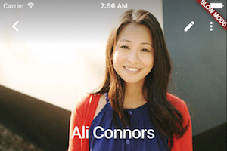
Stack
Uses Stack to overlay a Container (that displays its Text on a translucent black background) on top of a CircleAvatar. The Stack offsets the text using the alignment property and Alignments.
Uses Stack to overlay a gradient to the top of the image. The gradient ensures that the toolbar’s icons are distinct against the image.

Slide 33
Material widgets
Card: Organizes related info into a box with rounded corners and a drop shadow.
ListTile: Organizes up to 3 lines of text, and optional leading and trailing icons, into a row.

Slide 34
Card
A Card, from the Material library, contains related nuggets of information and can be composed from almost any widget, but is often used with ListTile. Card has a single child, but its child can be a column, row, list, grid, or other widget that supports multiple children. By default, a Card shrinks its size to 0 by 0 pixels. You can use SizedBox to constrain the size of a card.
In Flutter, a Card features slightly rounded corners and a drop shadow, giving it a 3D effect. Changing a Card’s elevation property allows you to control the drop shadow effect. Setting the elevation to 24, for example, visually lifts the Card further from the surface and causes the shadow to become more dispersed. For a list of supported elevation values, see Elevation in the Material guidelines. Specifying an unsupported value disables the drop shadow entirely.

Slide 35
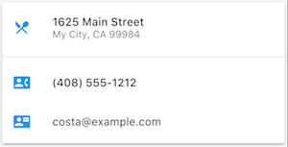
A Card containing 3 ListTiles and sized by wrapping it with a SizedBox. A Divider separates the first and second ListTiles.
Implements a Material card
Used for presenting related nuggets of information
Accepts a single child, but that child can be a Row, Column, or other widget that holds a list of children
Displayed with rounded corners and a drop shadow
A Card’s content can’t scroll
From the Material library

Slide 36
Widget _buildCard() => SizedBox(
height: 210,
child: Card(
child: Column(
children: [
ListTile(
title: Text('1625 Main Street',
style: TextStyle(fontWeight: FontWeight.w500)),
subtitle: Text('My City, CA 99984'),
leading: Icon(
Icons.restaurant_menu,
color: Colors.blue[500],
),
),
Divider(),
ListTile(
title: Text('(408) 555-1212',
style: TextStyle(fontWeight: FontWeight.w500)),
leading: Icon(
Icons.contact_phone,
color: Colors.blue[500],
),
),
ListTile(
title: Text('costa@example.com'),
leading: Icon(
Icons.contact_mail,
color: Colors.blue[500],
),
),
],
),
),
);

Slide 37
ListTile
Use ListTile, a specialized row widget from the Material library, for an easy way to create a row containing up to 3 lines of text and optional leading and trailing icons. ListTile is most commonly used in Card or ListView, but can be used elsewhere.
Summary (ListTile)
A specialized row that contains up to 3 lines of text and optional icons
Less configurable than Row, but easier to use
From the Material library

Slide 38
Build the layout
Follow me with the lab sheet here : https://flutter.dev/docs/development/ui/layout
Then Create an App to wrap up the layout
https://flutter.dev/docs/development/ui/layout/tutorial

